Slide 1


HUM 102 Report Writing Skills
Lecture 01

Slide 2

Course Outline [1/2]
Introduction to Report Writing
Structure of a Report
Types of Report
Basics of Writing Reports
Report Writing Strategies
Introduction to Technical Communication

Slide 3
Course Outline [2/2]
Objectives of Technical Writing
Writing Process
Presentation Skills
Overview of Technical Documents
Memoranda and Email
Letters
Understanding Plagiarism

Slide 4


What is a Report?
Structured Form of Writing
Identify
Organize
Examine

Slide 5

Characteristics
Structured with headings
Independent components sections
Impartial communication with facts and figures

Slide 6
Expectations
Problem solving hypothetical situation as the Topic
Provision of a proposal as the Purpose
Addressing a client or a manager
A format with headings
Objective language
Success with good research skills

Slide 7
Expectations
Problem solving hypothetical situation as the Topic
Provision of a proposal as the Purpose
Addressing a client or a manager
A format with headings
Objective language
Success with good research skills

Slide 8
Expectations
Problem solving hypothetical situation as the Topic
Provision of a proposal as the Purpose
Addressing a client or a manager
A format with headings
Objective language
Success with good research skills

Slide 9
Expectations
Problem solving hypothetical situation as the Topic
Provision of a proposal as the Purpose
Addressing a client or a manager
A format with headings
Objective language
Success with good research skills

Slide 10
Expectations
Problem solving hypothetical situation as the Topic
Provision of a proposal as the Purpose
Addressing a client or a manager
A format with headings
Objective language
Success with good research skills

Slide 11
Expectations
Problem solving hypothetical situation as the Topic
Provision of a proposal as the Purpose
Addressing a client or a manager
A format with headings
Objective language
Success with good research skills

Slide 12
Expectations
Problem solving hypothetical situation as the Topic
Provision of a proposal as the Purpose
Addressing a client or a manager
A format with headings
Objective language
Success with good research skills

Slide 13
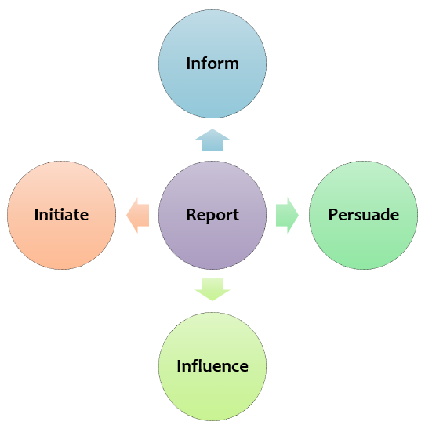
Purpose

Slide 14
Purpose

Slide 15
Purpose

Slide 16
Purpose

Slide 17
Purpose

Slide 18


Significance
Written communication within an organization following a hierarchy
Employer to employee
Employee to employee
Employee to employer

Slide 19
Relevance of Report
Means of internal communication
Facilitates decision making and planning
Discloses unknown information
Gives information to employees

Slide 20
Report Attributes
A report is a methodical, well-planned document which outlines and evaluates a subject or problem.
Essentially, a report is a short, sharp, concise document which is written for a particular purpose and audience.
It basically analyses a situation or problem, often making recommendations for future actions.
It is a factual paper, and needs to be clear and well-structured.

Slide 21

Features of a Well-Written Report
Clarity of thought
Complete and self-explanatory
Comprehensive yet compact
Presented in a lucid Style

Slide 22

Report vs. Essay
Reports are needed: Essays are used to present:
for businesses
for scientific and technical subjects
in workplaces
arguments
reasoning
logical conclusions

Slide 23

Report vs. Essay
Similarities
Introduction
Careful proof-reading
Neat presentation
Body
Conclusion
Analytical thinking
Formal style

Slide 24
Report vs. Essay
Key Differences: A report
presents information, not an argument.
may need an abstract, sometimes called an executive summary.
is often followed by recommendations.
is meant to be scanned quickly by the reader.
uses numbered headings and sub-headings.
uses short, concise paragraphs and dot-points, where applicable.
uses graphics wherever possible e.g., tables, graphs, illustrations.

Slide 25
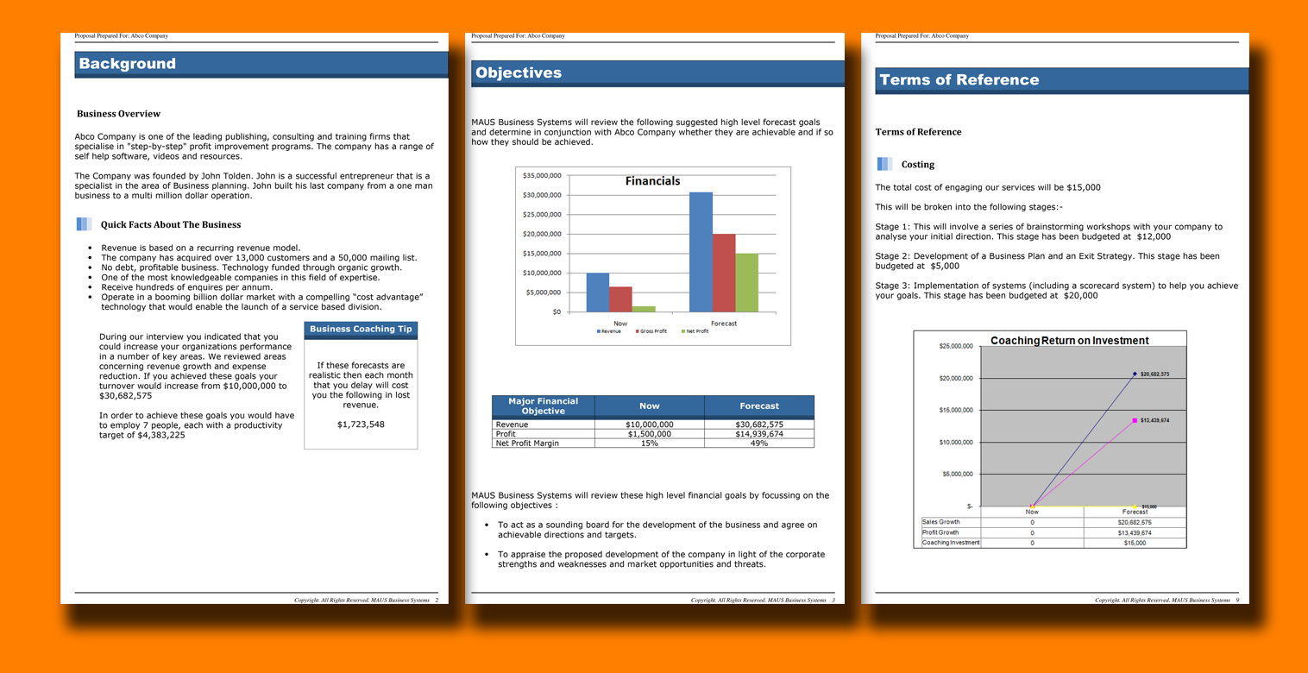

Slide 28
Qualities of a Good Report
Clarity
Definition of different concepts used
Careful use of terminology
Clarifies a problem
Presentable
Properly organized
Includes data
Short and compact
Authentic
Proper citations or bibliography

Slide 29
Conclusions
Basics of a report
Report characteristics
Expectation and purpose
Significance of a report
Relevance, attributes and features of a report
Comparison of a report and essay
Examples

